Slide 1
Prospecting 101
How consulting firms can find their target audience

Slide 2
Before you begin
Make sure you have access to our CRM (Hubspot)
Your contact and company card should look like <slides ahead>
Install the chrome and outlook plugins for hubspot
Always send tracked emails through these plugins
Install Allied’s Hubspot-LinkedIn Plugin (release expected mid Nov 2015)
http://chrome.google.com/webstore/developer/edit/ggmfaagcmmldgjdkadgggpflnnkbphjf
Understand the play
Understand the target segment and why we are prospecting them
Notes:
https://knowledge.hubspot.com/articles/kcs_article/settings/how-to-install-hubspot-sales

Slide 3
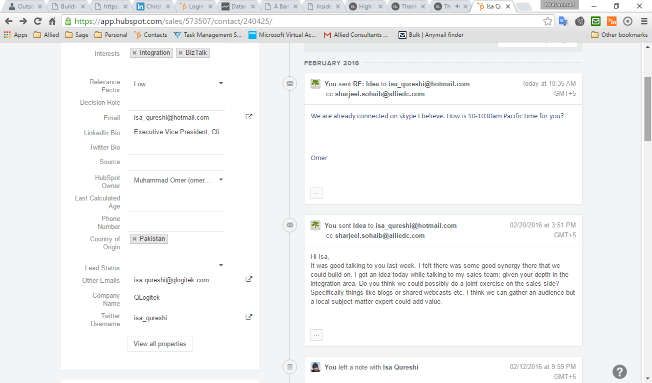
Contacts Card

Slide 4
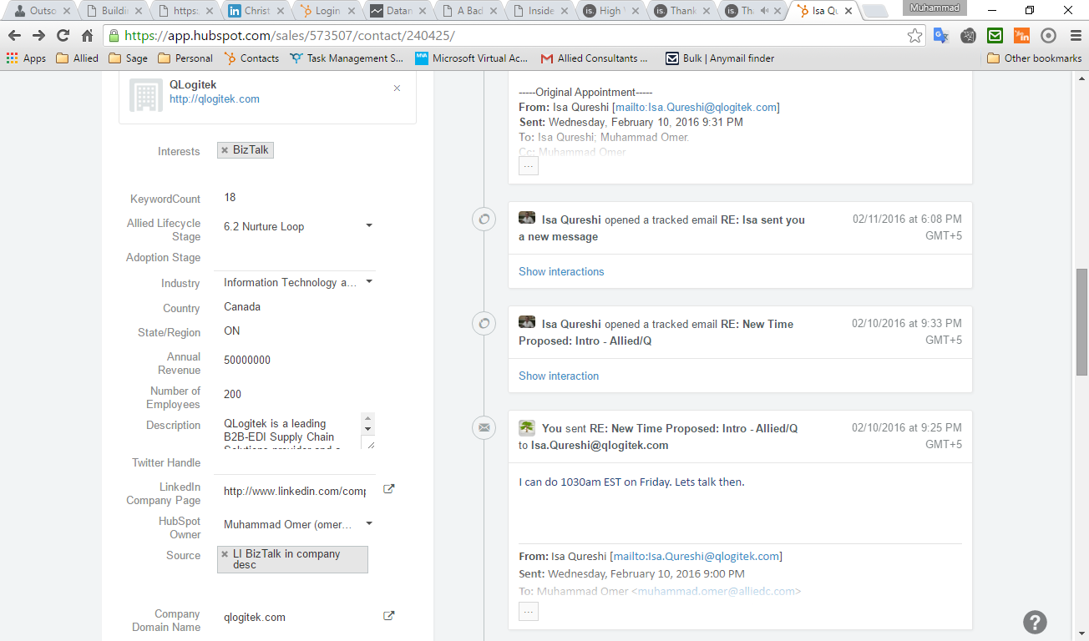
Company Card

Slide 5
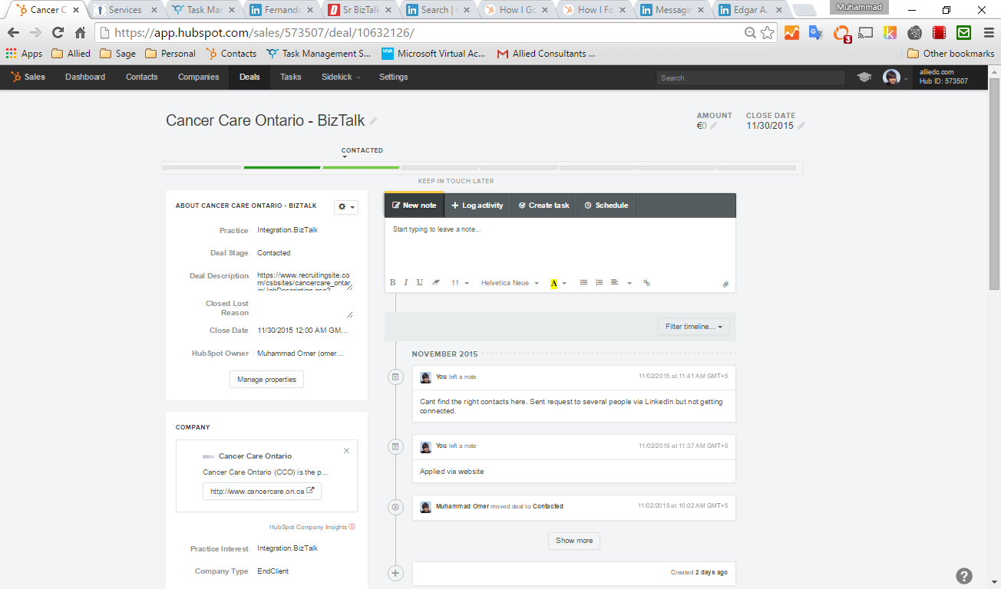
Deal Card

Slide 6
Explanation of the fields

Slide 7
What is the purpose of prospecting
Validating a segment
Validating/Refining Pitch

Slide 8
Major types of companies (for our purposes)
End clients (do something else but use BizTalk to make their business better)
Enterprise
Software Product firms
Startups
Consulting firms (sell services around BizTalk)
Development or System Integrators (SIs) – Plan, Architect, Built and maintain on top of the product
Misc
License resellers
Sysadmin (setup, install and maintain networks) – dying because of cloud
Trainers
Recruiters

Slide 9
Segments (formally called campaigns)
Dimensions
Practice Interest
Location
Size
Industry
Buying Stage
Company type (end client vs. consulting firm)
Clusters
Consulting firms
End Clients
Recruiters, Evangelists, License Re-sellers, Management Consulting firms etc…

Slide 10
Prospecting lifecycle
Identify a company (generally on the basis of search criterion)
Find contacts (you will likely find several people)
Contact them and confirm the degree of involvement in xxx
Try to work up and down the hierarchy to find the decision maker
Qualify the company (confirm that it does xxx) *
Find the decision makers
Introduce yourself and check for immediate opportunities
Back off and nurture for 6mo
Notes:
* This could potentially happen without contacts

Slide 11
Allied Lifecycle stage
1.Attempting company Qualification
/Blank
2.1 Company Qualified
3.1 DM / Strong influencer Found
4.1 Email found
5.3 DM Responded
5.1 Delivered
5.2 Delivered-Opened
(follow up if they don’t respond in a few days)
4.2 Email not found
3.2 DM/Strong Influencer Not found
2.2 Company Unqualified
6.1 Nurture Loop
2.3 Cant Qualify
6.3 Not interested
(ask for referral)
6.2 In discussion
6.3 Stay-in-touch

Slide 12
6.1 Nurture Loop
7.Opportunity
8. Current Client
9. People you worked with/Studied in the past

Slide 13
How to find companies that do xxx
Google Search
Search LinkedIn
People – skills, current title, past job history
Search directories (e.g. Microsoft partner directory)
Search Jobs Boards for current (and past) jobs
Crawl Social Media for people talking about the topic
Notes:
Organize on effort

Slide 14
Beware of
Duplicate company entries. Always check before you add
In the CRM www.company.com is a different company from company.com . Use the later.
Searching “Cancer Center America” is not the same as searching Cancer Center America
Track everything (observations, thoughts etc. in CRM Notes)
Don’t get lost, its easy to get distracted by other prospects in the suggestions on the right etc. Make sure you have a list and are following it religiously. The other contacts will show up there eventually.

Slide 15
Qualifying Companies
Mentions BizTalk in their description
Google search on “site:domain.com bizTalk” results in matches
A LI search for keyword=biztalk, company=xxx results in matches. Need to make sure these people currently work in BizTalk.
Their latest project description/job title etc mention BizTalk or Integration
Skills, Biztalk mention in older projects etc, are signs but indicate weak connection

Slide 16
Finding Contacts
LinkedIn
Keyword search, “Similar Contacts”, Members of groups, people in previous (relevant jobs)
Google (website)
Guessing email addresses (very effective)
Data.com, Zoominfo.com
info@company.com, hr@company.com …
http://www.getsidekick.com/blog/outsource-finding-email-address

Slide 17
Qualifying contacts?
Ideally you are looking for decision makers (directors, Managers, VPs).
Influencers (Developers, Architects etc.) are useful for intelligence but not decisions.
Location of the post and person is important, managers usually are physically co-located with their team
A “companyX biztalk” search can result in people who USED TO work in CompanyX in the PAST. Ideally you are looking for current employers
People who endorse BizTalk (as a skill) are also relevant. Particularly DMs from endorsement lists are very useful (since they don’t otherwise mention BizTalk in their profile)

Slide 18
Qualifying contacts 2- Indicators of high contact relevance
BizTalk keyword mentioned often
BizTalk keyword mentioned in current project
Number of endorsements for BizTalk skill are high
Group subscriptions mention BizTalk. Lots of groups

Slide 19
Tools
Web Crawlers (Webscraper.io, Kimono.com)
We have a crawler that takes a LinkedIn query and outputs an excel sheet of all current and past companies, job titles etc.
Finding emails
Guessing: http://anymailfinder.com/
https://www.distilled.net/blog/miscellaneous/find-almost-anybodys-email-address/
http://www.getsidekick.com/blog/guess-email-with-sidekick
http://life-longlearner.com/find-email-addresses/
https://www.toofr.com/
http://www.yesware.com/blog/find-email-addresses/
Whois search against company domain name (particularly useful in very small companies)
https://www.voilanorbert.com/
https://emailhunter.co/
http://www.smallbusinessideasblog.com/find-email-addresses
Excel Pivot tables
Mail merge https://tubeunblock.com/watch?v=-6BwbTcs5VQ
Notes:
Beware: crawler restart from 0 if interrupted.

Slide 20
Qualifying Contacts
Size of company – Ideally 1-50
Keywords (Practice Interests and their synonyms)
Are frequently used
Are used in RECENT projects
Listed as a skill
Types of contacts
Decision maker (Most important people) – “VP of integration services, Manager BizTalk, Manager..”
Gatekeeper (only worth neutralizing) – Architects
Influencer (also important) – Business Analysts
Accomplices – e.g. Pakistanis working in the company
Top down, Bottom Up approach to finding decision makers
Not recruiters
Group subscription is a strong indicator

Slide 21
LI Qualification search tips
Doesn’t let you search for a keyword in CURRENT jobs only.
Company search:
Filter by keyword (and location if a large number)
People search:
Filter by company and location (lots of old experiences around keyword will come up)
Those with keyword in the title and/or current project/experience description
Those subscribing to relevant groups should be ranked higher
Rest

Slide 22
Qualifying Companies

Slide 23
Minimum fields you should capture
Mandatory
Name
Practice interest
Source
LinkedIn Profile
Also (if available)
Email
Note: this will largely become redundant after the plugin

Slide 24
Beware of
LinkedIn Limitations
How much time you spend chasing shadows
If you export fields with commas in their data (e.g. “Engineer, At company X”), the CSV export doesn’t always work properly with webcrawler.io

Slide 25
At the end your CRM data should be able to answer the following queries
What companies have or work with BizTalk?
What people work in BizTalk in a certain geography, type of company, industry etc.
Ideally, also have some details on what within BizTalk they work in
Who are the people we need to nurture? (Buying stage)
When was the last time we talked to a certain person (and be able to see the conversation history)

Slide 26
Typical times (per 500 contacts)
Coming up with a list of companies
Coming up with a list of email addresses
Contacting

Slide 27
Segment Prospecting report
Should contain
What cross-section of dimensions you focused on/tested
How many contacts/companies you found
How many emails you sent out
How many were delivered/opened
Templates that worked/didn’t work
How many calls setup?
Commonalities you found
Content you think will interest them
Places they hand out
Common Keywords etc.

Slide 28
Initiating emails
Refer reports
More information about customer will warm up the conversation??
Whats wrong with this email:
Whats in common with these?
They are evolving too…
Build report http://changingminds.org/techniques/conversation/rapport/rapport.htm
Don’t sell, don’t even sound like you are selling

Slide 29
General advice on emails
Refer to them by name
Write no more than a few lines (mobile friendly)
Say something that shows interest in THEM specifically.
What differentiates your email from a generic spam mail?

Slide 30
Get Yourself considered
Looking to apply for a job, do you have an opening or are interested?
“Do you have BizTalk consultants”
I’m doing a survey / research for an article etc…
Why do you feel they need your services?
I noticed that you partner with Microsoft, can we be your white-labelled offshore delivery service partner?

Slide 31
Validate
“Does your company do BizTalk work?”
Sent to Info@company.com
Keep it short
Leave ambiguous and sound like a client (without actually saying that you are)

Slide 32
Right place
Search for your keyword on LinkedIn
By location
Compare to other practices
Check “google trends”
Look at the practice development template
20% of the companies will have 80% of the work in all geographies
Unless its yours strategy to target the small players
There is no right approach
SYSTEMATICALLY testing segments is the only way to go
There are no easy ways to do it – its all hard work

Slide 33
Thing to try (in this order)
Job Digest – lowest hanging fruit
Currently open job posts
Past Job posts (last 6mo)
Opportunistic
Segment Analysis (Systematic)
Consulting firms with lots of activity in your area
Self description on LI or website or MS partner directory in a certain practice
Companies with less/occasional work (with less competition)
This can still be very lucrative
Give finding contacts of high relevance companies a second try
Work on your influencers
Recruiters?

Slide 34
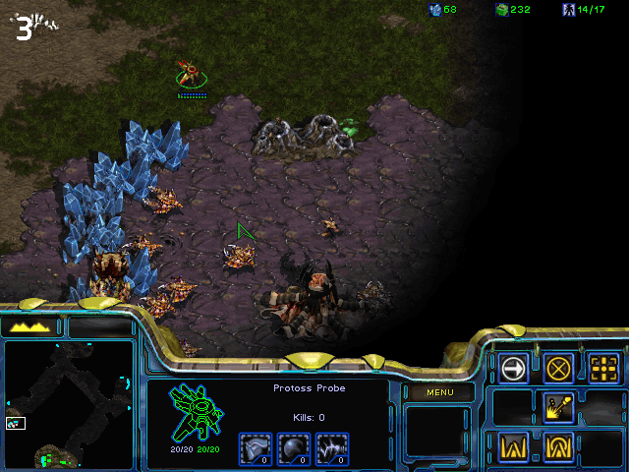

Slide 35
Thoughts on the Job digest
Right time
Right Place
Finding the right person (see prospecting 101)
Usually want to hire permanent (not subcontract)
Usually want someone onsite, on premises

Slide 36
Thoughts on picking segments
Classical Dimensions: Location, Industry, Company Size
Minor: Ethnicity, Age, Interests, <add yours>
I go by
Location – pick a country/state with a high growth rate
Find consulting firms (these are generally clusters of this work)
Find customers (via LinkedIn)

Slide 37
Other Resources
Crash course in sales prospecting
http://pages.yesware.com/sales-prospecting.html
http://www.tropical.io/blog/7-tips-for-stellar-sales-prospecting-emails
https://www.aa-isp.org/inside-sales-resources.php?type=3
http://www.kenkrogue.com/inside-sales-training/
http://www.insidesales.com/webinar/31-inside-sales-must-haves-confirmation
Find Anyone’s phone number
http://www.kenkrogue.com/best-practices/inside-sales-best-practices-gathering-direct-dial-phone-numbers/

